Slide 1
DDOS Attack
Problems and Defence Frameworks

Slide 2
Introduction
DDOS attacks is one the major network security threat.
During years was developed many security system against DDOS that protect from specific attacks but not from general.
To successfully handle DDOS attack is necessary a distributed framework composed by cooperative heterogeneous nodes.

Slide 3
DDOS: Problem
DDOS attacks occurs when multiple machine generate large traffic volume to a victim occupying resources and so generate a Denial of Service.
Feature of DDOS that can hinder defence:
Large volume: A really big traffic volume can overwhelm also defence systems.
Seemingly legitimate packets: Attack packets can be identical to legit packet and a defence system cannot reach a decision based on individual packet.
IP spoofing: Attacker use a fake source address to disguise defence system

Slide 4
DDOS: Solution
The solution for DDOS attack is to detect it and cut off the attack stream. To successful in this the defence system has to have the following features.
Feature of DDOS defence system:
Accurate Detection: The system must detect most of the attacks
Effective Response: The system must reduce the attack flow to manageable levels, regardless volume and distribution.
Selective Response: The system must be able to differentiate between legitimate and attack packets and ensure good service to legitimate traffic during attack.

Slide 5
DDOS: Current Defence Paradigm
The current paradigm used from defence system lead to poor performance, it is necessary a paradigm switch.
Current Paradigms:
Autonomous Defence: Security system can be situated in the victim network to detect anomalous behavior but in this case the defence system can be overwhelmed, if the system is situated in the intermediate network like in a router it has to analyze an high traffic and is difficult to grant selective response.
Distributed Defence: Is evident that one system deploy is not sufficient, so is necessary to use cooperative distributed nodes through internet. Those node operate by them in isolation from other defence system.

Slide 6
DDOS: New Defence Paradigm
General DDOS threat is still unmitigated so we need new paradigms
Node specialization: Nodes are specialized and cooperate to detect and repair attacks , attack detention is done near the victim, response is more effective near the attacker. Using also intermediate nodes help to identify if a data flow is legacy or malicious
Heterogeneous cooperative defense: To have a successful DDOS defense is necessary a really high deployment of defence node. To obtain a really accurate defence system is necessary to have heterogeneous system where nodes cooperates with other nodes of different provider

Slide 7
Distributed framework for DDOS defence
To move from isolated to cooperative defence is needed a new framework, three types of nodes:
Alert generator: detect attack and warn other node.
Core: rate limit the high volume traffic.
Classifier node: perform selective rate limit differentiating between legitimate flow and attack flow.
Cooperative nodes must support the following messages:
Attack alerts: Authenticated alerts should be propagated in the network.
Rate-Limit request: Each node communicate to other node the rate limit traffic.
Resource request: Each node can request resources to downstream node.
Traffic classification: Classifier node can communicate information to ensure that legitimate traffic will not be dropped

Slide 8
DefCOM
Heterogeneous cooperative defense
Example design of DDOS defence framework.
Heterogeneous defence nodes organized in a peer-to-peer network.
During an attack the system discover the victim traffic tree and identify the upstream-downstream relationships.
The nodes then set an appropriate traffic limit and differentiate legit and attack streams.

Slide 9
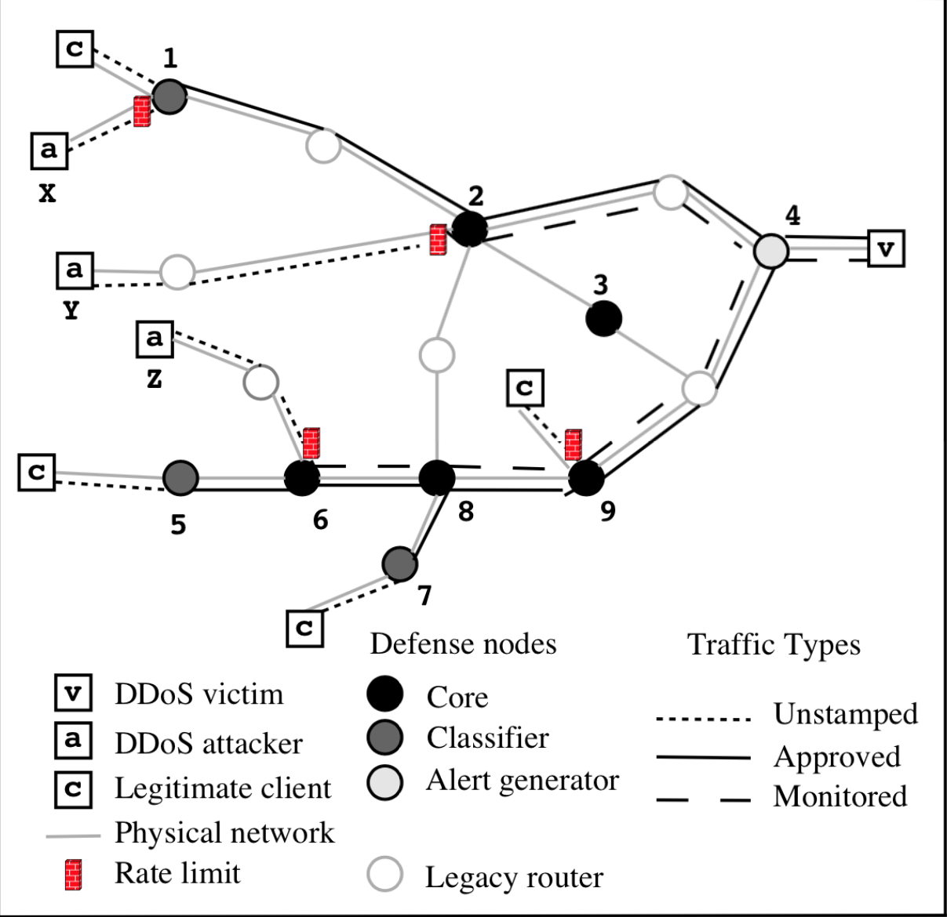
DefCOM: Traffic Tree Discovery
When an attack occur the alert generator node closest to victim detect it and send alert message to other nodes.
The others nodes cooperate analysing the traffic to trace the victime traffic tree and define upstream and downstream nodes using stamp messages.
DefCOM has the problem of falsely reporting DDOS attacks, if a malicious user report a false attack the system will decrease the traffic rate limit. This problem is solved by signing the messages.

Slide 10
DefCOM: Distributed Rate Limiting
The nodes cooperate to deploy rate limits. The limit is deployed on the leaf of the tree to reduce congestion.
The rate is propagated from root of the tree downstream, each node assign an equal part of his rate limit to the children via rate-limit request.
The rate limit can be modified by resource request because some child-node may need more bandwidth for legitimate clients.

Slide 11
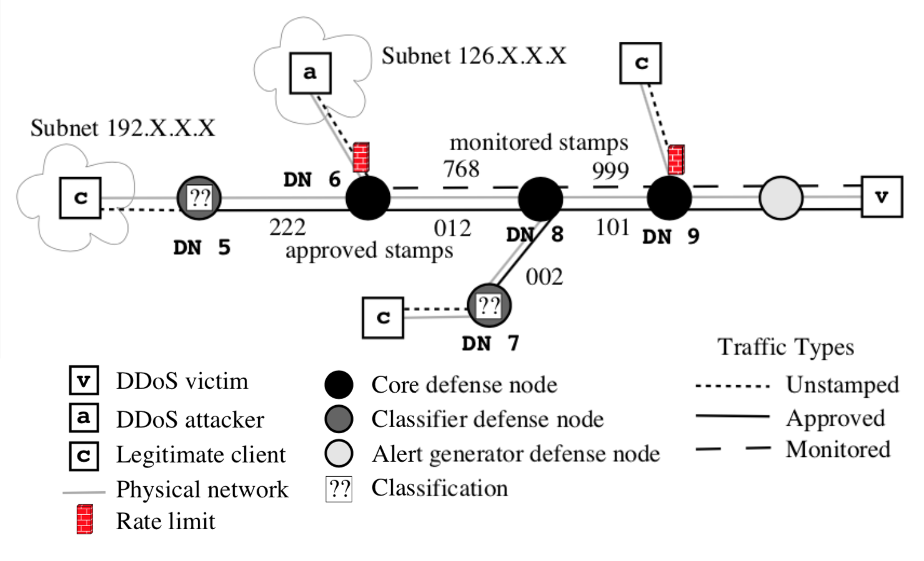
DefCOM: Differentiated Service for Legitimate Traffic
Classifier defense node analyse the packets and if they are legit mark them as approved-traffic.
The traffic that surpass the rate limit in the core nodes are marked as monitored-traffic
Served traffic list in core nodes:
Approved traffic
Monitored traffic
Unstamped traffic

Slide 12
DefCOM: Framework Security
Service deny: Malicious node is able to deny service to legit client under it but not to other nodes cause of the strictly traffic from the parent.
Attack hiding: Malicious node can stop attack alarms but can be mitigated using a redundant alternative path.
Stamp tampering: If an attacker can discover the approved stamp he can get priority for his attack traffic this can be mitigated using enough bits in the stamp.

Slide 13
FireCol
Distributed Defence
FireCol is a collaborative system that detects flooding DDoS attacks as far as possible from the victim host and as close as possible to the attack source.
FireCol has a distributed architecture composed of multiple IPSs (Intrusion prevention systems) forming a networks of protection rings around subscribed customers.
The IPSs near to each customers form a virtual protection rings around the host and cooperates exchanging scores on potential attacks.

Slide 14
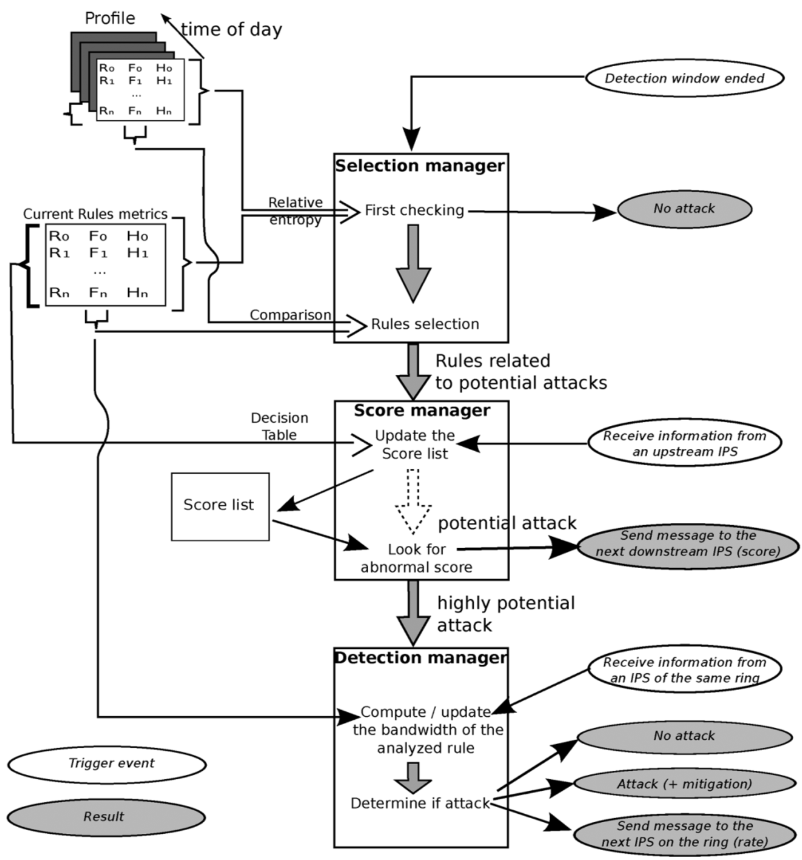
FireCol Architecture: Ring-Based Protection 1
Each IPS instance analyzes traffic with a configurable detection window.
After the selection manager measures the deviation of the current traffic profile from the normal ones, selects the rules (traffic filter) and forwards them to the score manager.
Using a decision table, the score manager assigns a score to each selected rule based on the frequencies, the entropies calculated by metrics manager, and the scores received from upstream IPSs.
Notes:
FireCol Components: Packet Processor, Metrics Manager, Selection Manager, Score Manager, Detection Manager.

Slide 15
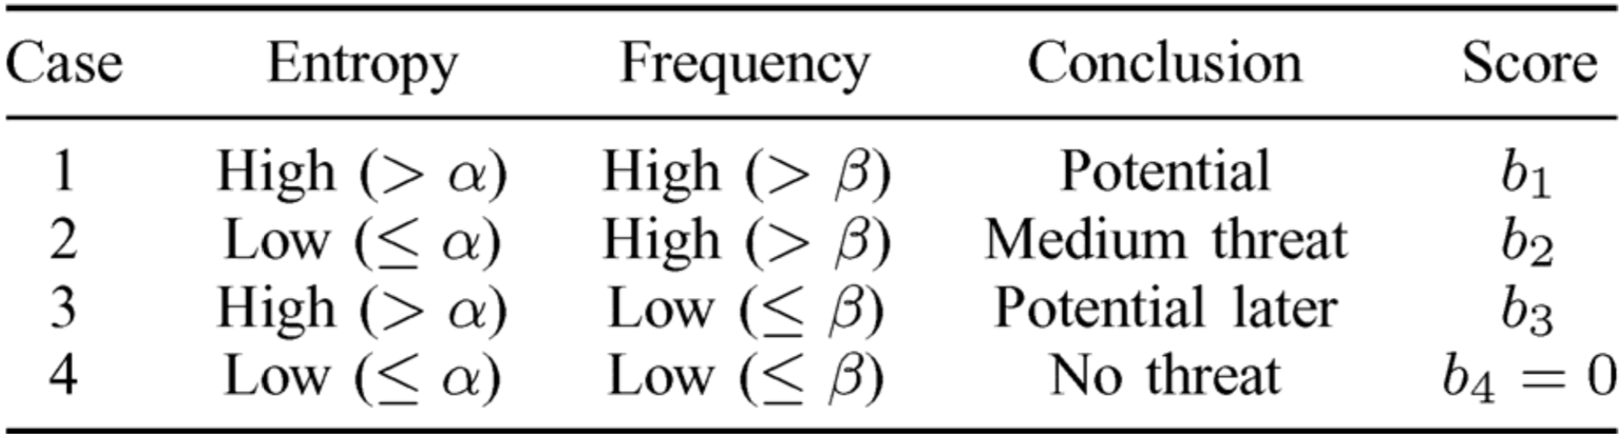
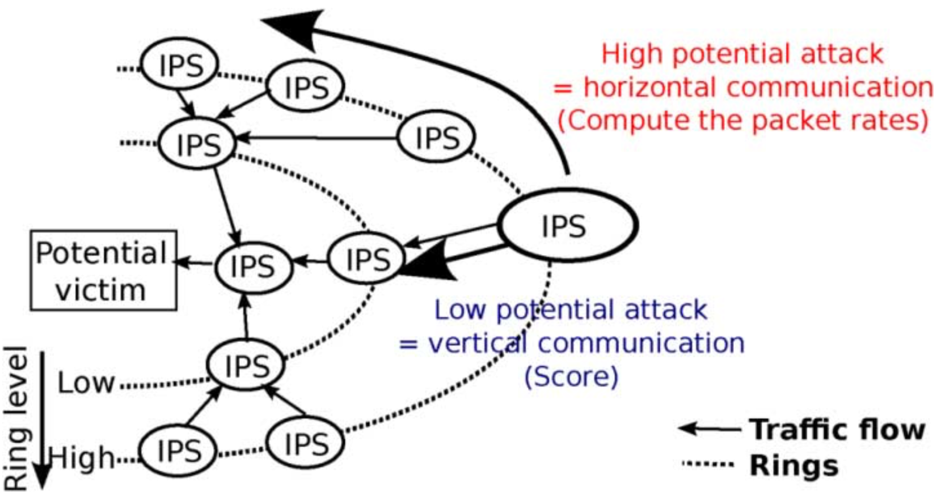
FireCol Architecture: Ring-Based Protection 2
The score for each rules is calculated based on entropy and frequency, the low scored rules are marked as a low potential attack and is communicated to the downstream IPS that will use it to compute its own score.
An high score on is marked as high potential attack and triggers ring-level (horizontal) communication in order to confirm or dismiss the attack.
The detection manager decide if there is an attack in course.
Notes:
packet rate is calculated based on the average traffic of orizontal node.

Slide 16
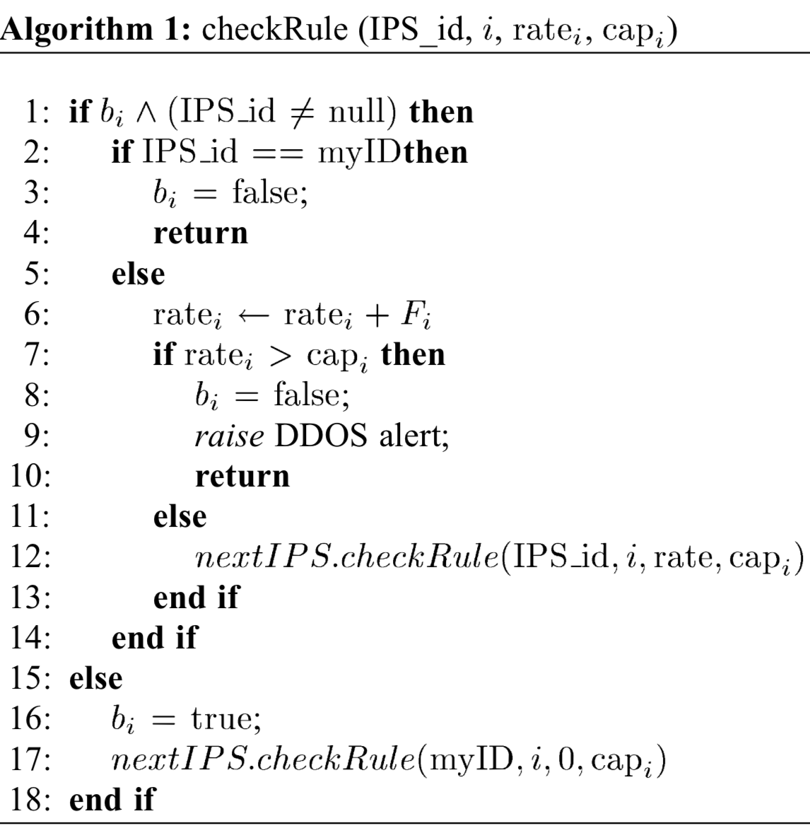
FireCol: Attack Detection Algorithms
The detection manager computes the corresponding packet rate using rule frequencies and the bandwidth consumed during the last detection window and communicate with others node horizontally.
Is bi false? Yes → Start new traffic check , No → Traffic check ongoing.
Is MyID the Initiator? Yes → No attack, No → Adding own rate.
Is max rate reached? Yes → Raised alert, No → Check next ip.
#Check Initiator
#No attack
#Adding current rate
#Attack detected
#Check next IPS
#Starting new traffic checking

Slide 17
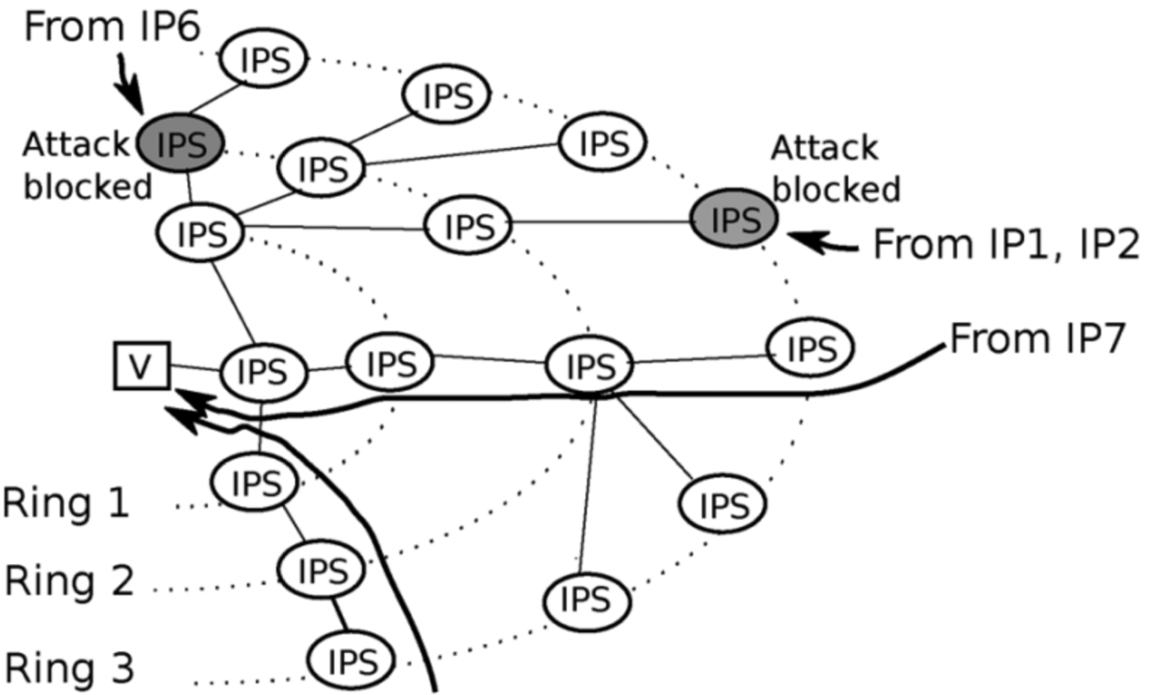
FireCol: Mitigation
When an attack is detected, FireCol form a protection shields around the victim to block the attack.
The IPS that detects the attack informs its upper-ring, which enforce the protection at their ring level.
To extend the mitigation, the IPS that detects the attack informs also the nodes on the same ring to block traffic related to the corresponding rule.
Only traffic from suspected sources is blocked as shown in figure.

Slide 18
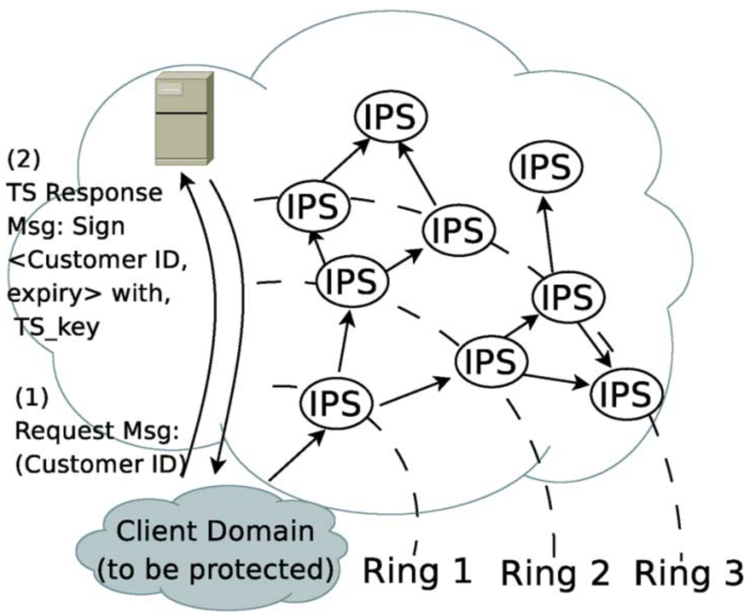
FireCol Architecture: Subscription Protocol 1
Customers can subscribe to FireCol service using the protocol.
When a customer subscribes for the FireCol protection service, the trusted server saves an entry with user ID.
The server then issues periodically a signed token to the user.

Slide 19
FireCol Architecture: Subscription Protocol 2
To build and update the ring network is used a two phase process.
The router sends a message to the customer containing a counter initialized to 0. The counter is incremented each time it passes through an IPS.
The customer then replies to the router with the value of its ring level.
Notes:
The ring level value is strongly network-dependent.

Slide 20
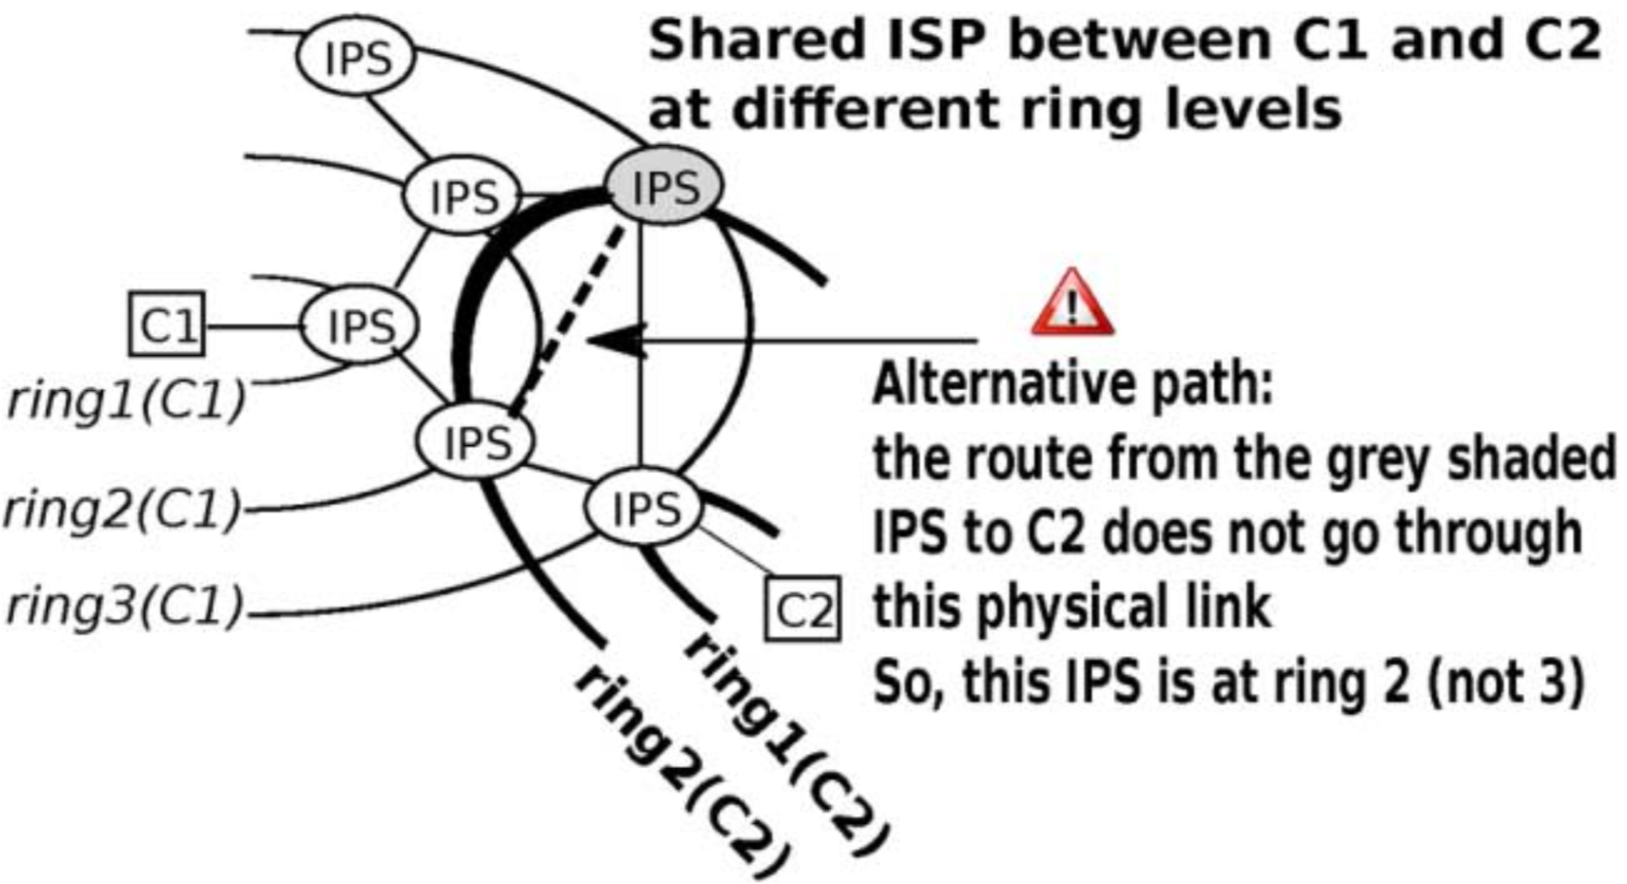
FireCol Architecture: Multiple Customers
FireCol allows the coexistence of multiple virtual protection rings for multiple customers across the same set of IPSs.
A single IPS may work at different levels and path for different customers

Slide 21
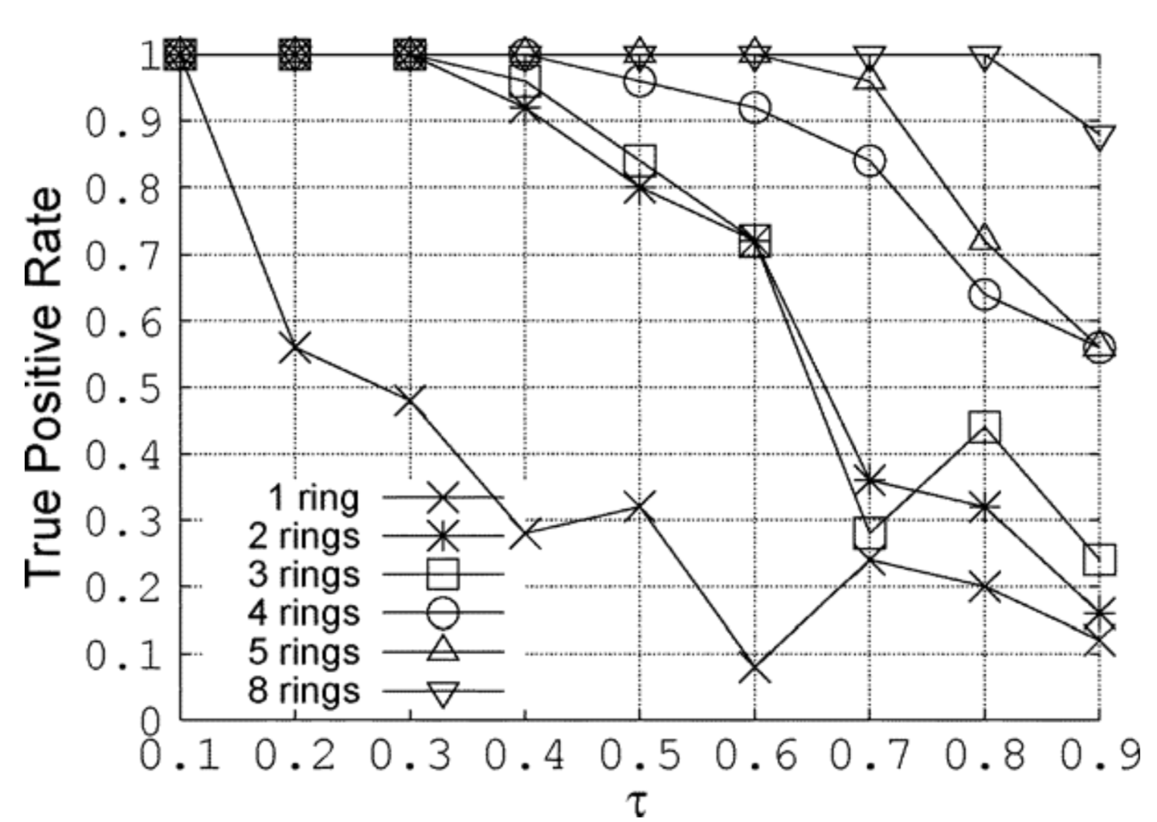
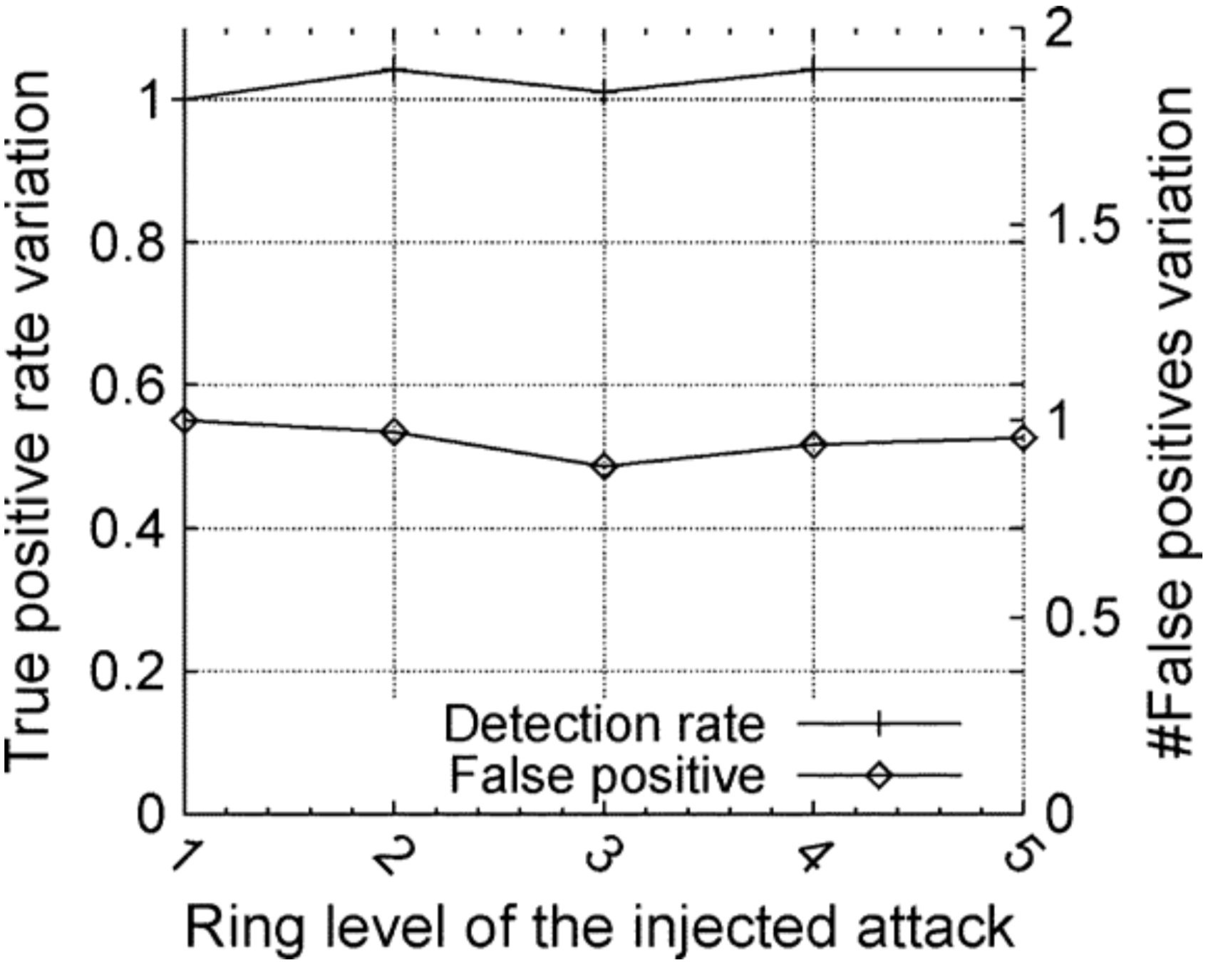
FireCon: Evaluation 1
To evaluate the accuracy of FireCol multiple experiments have been done:
Impact of the score threshold: Want to find the optimal threshold for each topology evaluating the TPR attacks, the purpose is to find the highest threshold value that maintain an high TPR, for example for 5 ring the optimal t value is about 0.7.
Ring level of attack: An attacker might launch an attack in the vicinity of the victim avoiding high-level rings. Instead of decreasing the threshold for detect attack at low-level, the benign traffic is also analyzed by the upper rings, which helps in distinguishing it from the malicious ones.
in Ring 5
Notes:
The second image shows that a five-rings topology can also detect attacks from lower-order rings.

Slide 22
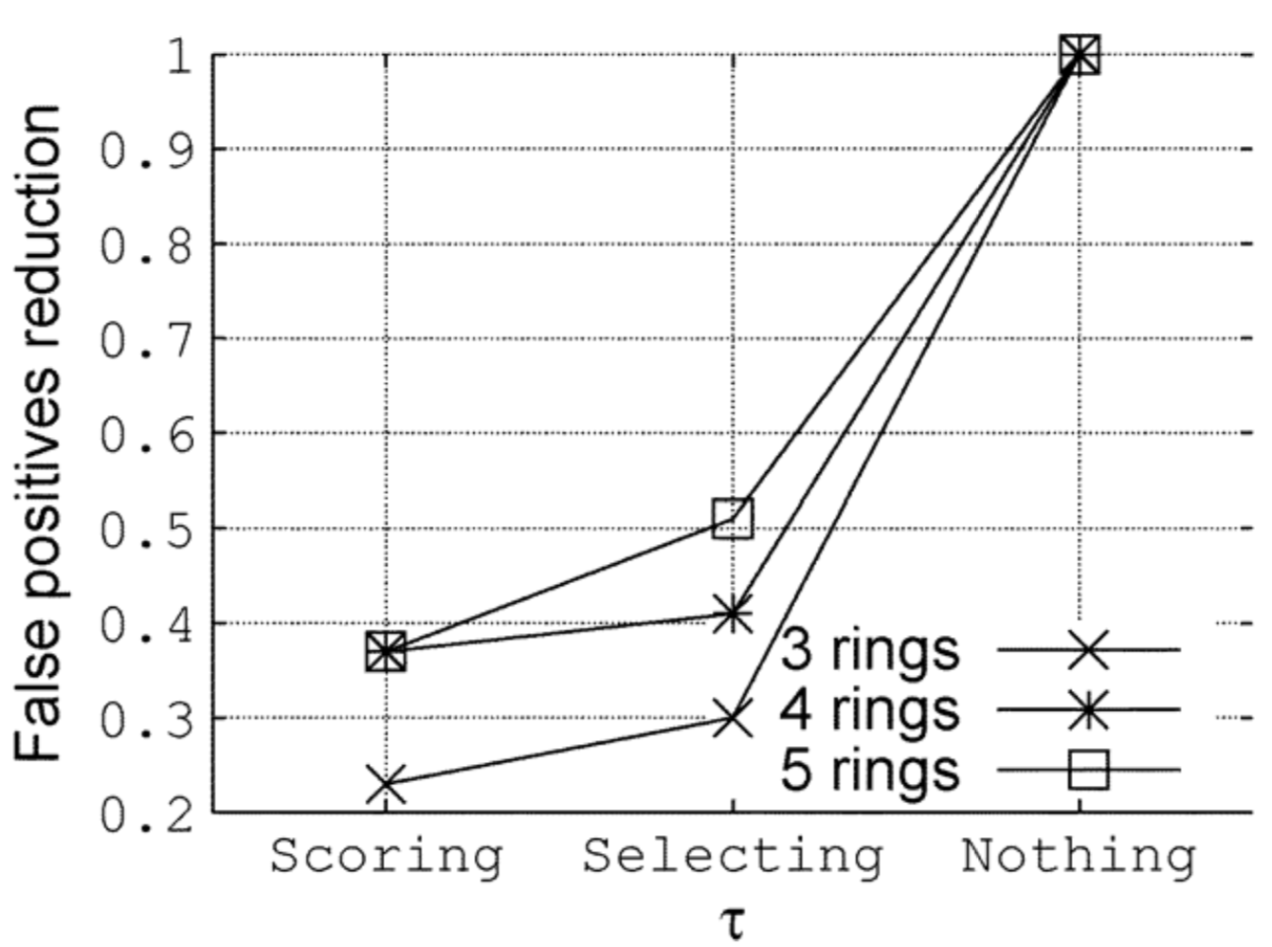
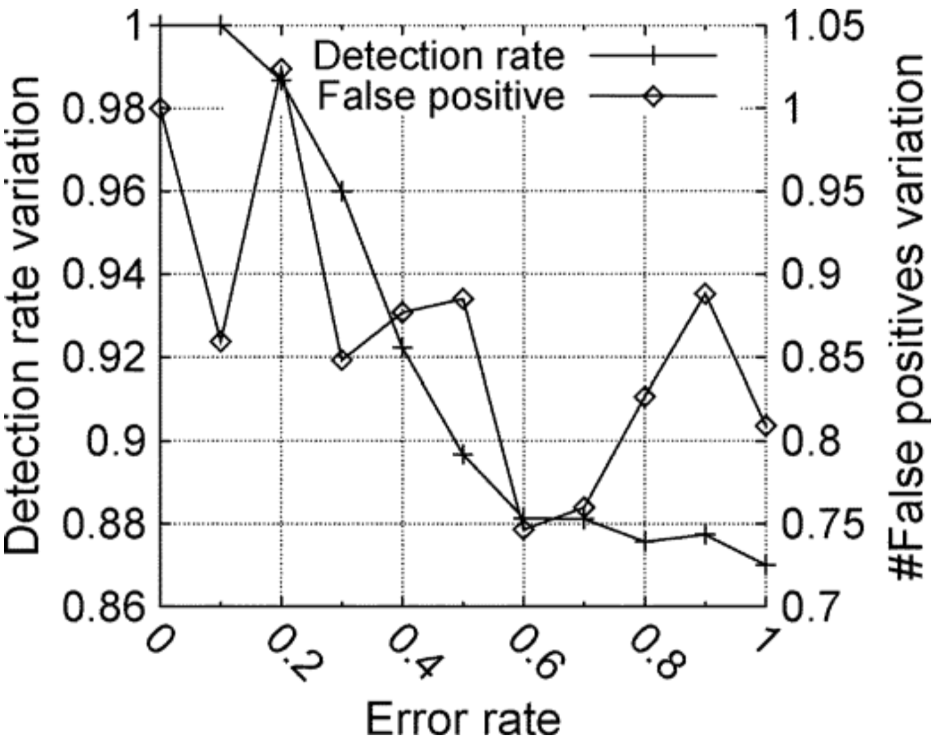
FireCon: Evaluation 2
Efficiency of the MultiLevel Approach: The first value represents the results when both the selection and score managers are enabled. The second value is when only the selection manager is enabled. The selection manager reduces the number of FPs by more than 50%.
Configuration Errors: When an IPS is assigned to the wrong ring it is a configuration error. The TPR is never affected by more than 14% since a misconfigured IPS still continues to send information to another IPS. The variation of FP is more chaotic, however quite limited. This concludes that FireCol exhibits good robustness against configuration errors.

Slide 23
Conclusion
DDOS attack is one of the major security threat that cannot be mitigated by isolated solution.
Various defence system composed by nodes must interoperate exchanging information and services to obtain an high level of security.

Slide 24
Thanks for the attention!

